Slide 1
Suggestions For Review:
Study with a partner
Cover microscope slides for quizzing each other
Be specific in your answers (e.g. is “Tibia” or “Fibula”, not a mix of the two words…!)
When quizzing each other, try to give written answers in addition to verbal answers. This can increase retention, improve spelling and prevents you from the shock of having to spell out some of the words for the first time during the practical.
Good Luck!

Slide 2

B231 – Anatomy & Physiology 1
Lab section Spring 2020
Dr. Kroeger
Daniel.kroeger@simmons.edu
dkroeger@bidmc.harvard.edu
Office hours:
by appointment
(email me)

Slide 3
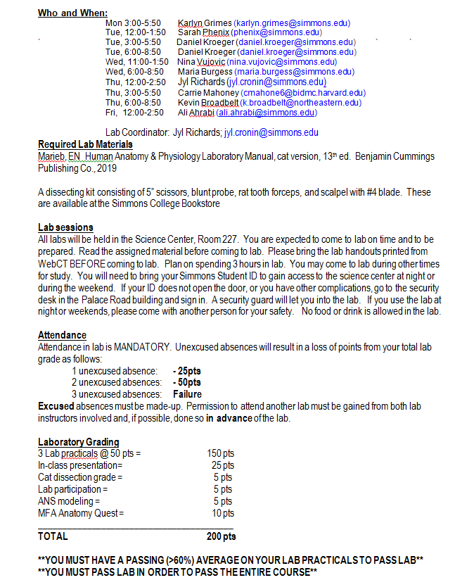
Need to have lab manual, which will also be used in A&P 2
(any edition is fine)
Dissection kit would be good.
Be prepared BEFORE the lab.
A&P requires study outside of lab time – doors are open. On weekends, ask public safety to open the door
Attendance is mandatory.
Lab practicals – be specific!
Presentation – more info on Moodle.
ANS modeling: poster presentation.
MFA Anatomy Quest: fun activity – more info later.

Slide 4
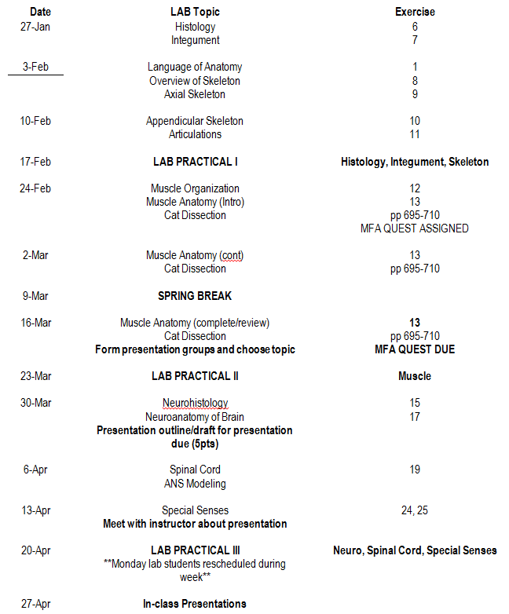

Slide 5
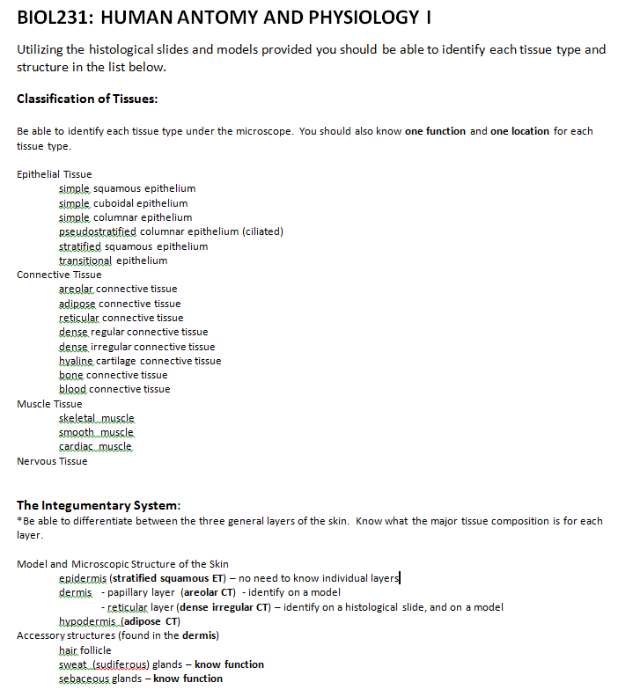
Important:
For the lab practicals you will only be asked to provide the level of detail outlined on the weekly instructions NOT the level of the lab manual.

Slide 6
How to identify what I see under the microscope?
A. Does the tissue have a free surface? In other words, is there a continuous sheet of cells which is bounded by other cell tissue on only one side?
No: connective tissue, muscle tissue or nervous tissue (go to B)
Yes: epithelium (continue below)
1. Is there a single, distinct layer of cells?
No: pseudostratified or stratified epithelium (go to 2)
Yes: simple epithelium (continue below)
a. Do the cells appear flat, with little cytoplasm around the nucleus?
No: simple cuboidal or simple columnar epithelium (go to b)
Yes: simple squamous epithelium
b. Do the cells appear square, with a round nucleus near the center?
No: simple columnar epithelium (go to c)
Yes: simple cuboidal epithelium
c. Do the cells appear rectangular, with an oval nucleus near the middle or toward the side furthest from the free surface? (Note: the nuclei of adjacent cells should be at about the same height.)
No: reconsider the previous options
Yes: simple columnar epithelium (continue below)
2. Do the cells appear to be predominantly columnar, but adjacent cells are of different height with nuclei staggered up and down (i.e. some cells do not reach the surface)?
No: stratified epithelium (go to 3)
Yes: pseudostratified columnar epithelium
http://www2.yvcc.edu/histologyzoomer/HistologyTutorials/dichotomousKey.htm

Slide 7
Btw – “stratified” usually means it is for PROTECTION
3. Given that you are looking at stratified epithelium,
a. Do the cells at the apical (free) surface appear flat, with little cytoplasm around the nucleus or with no visible nucleus?
No: stratified cuboidal or stratified columnar epithelium (go to b)
Yes: stratified squamous epithelium (continue below)
(1) Do the cells at the apical surface contain nuclei?
No: nonkeratinized stratified squamous epithelium
Yes: keratinized stratified squamous epithelium
b. Do the cells at the apical surface appear square, with a round nucleus near the center?
No: stratified columnar epithelium (go to c)
Yes: stratified cuboidal epithelium (Note: this tissue is typically two cell layers thick.)
c. Do the cells at the apical surface appear rectangular, with an oval nucleus near the middle or toward the side furthest from the free surface?
No: transitional epithelium (go to d)
Yes: stratified columnar epithelium
d. Do the cells at the apical surface appear dome-shaped (or as a mixture of flat- and dome-shaped)?
No: reconsider the previous options
Yes: transitional epithelium
http://www2.yvcc.edu/histologyzoomer/HistologyTutorials/dichotomousKey.htm

Slide 8
Epithelial Tissues

Slide 9
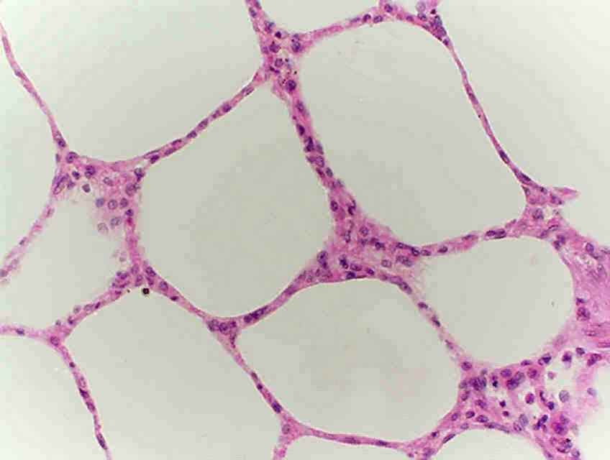
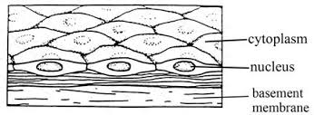
Simple squamous, alveoli of lung,
Absorption/exchange
Notes:
Simple squamous, alveoli of lung

Slide 10
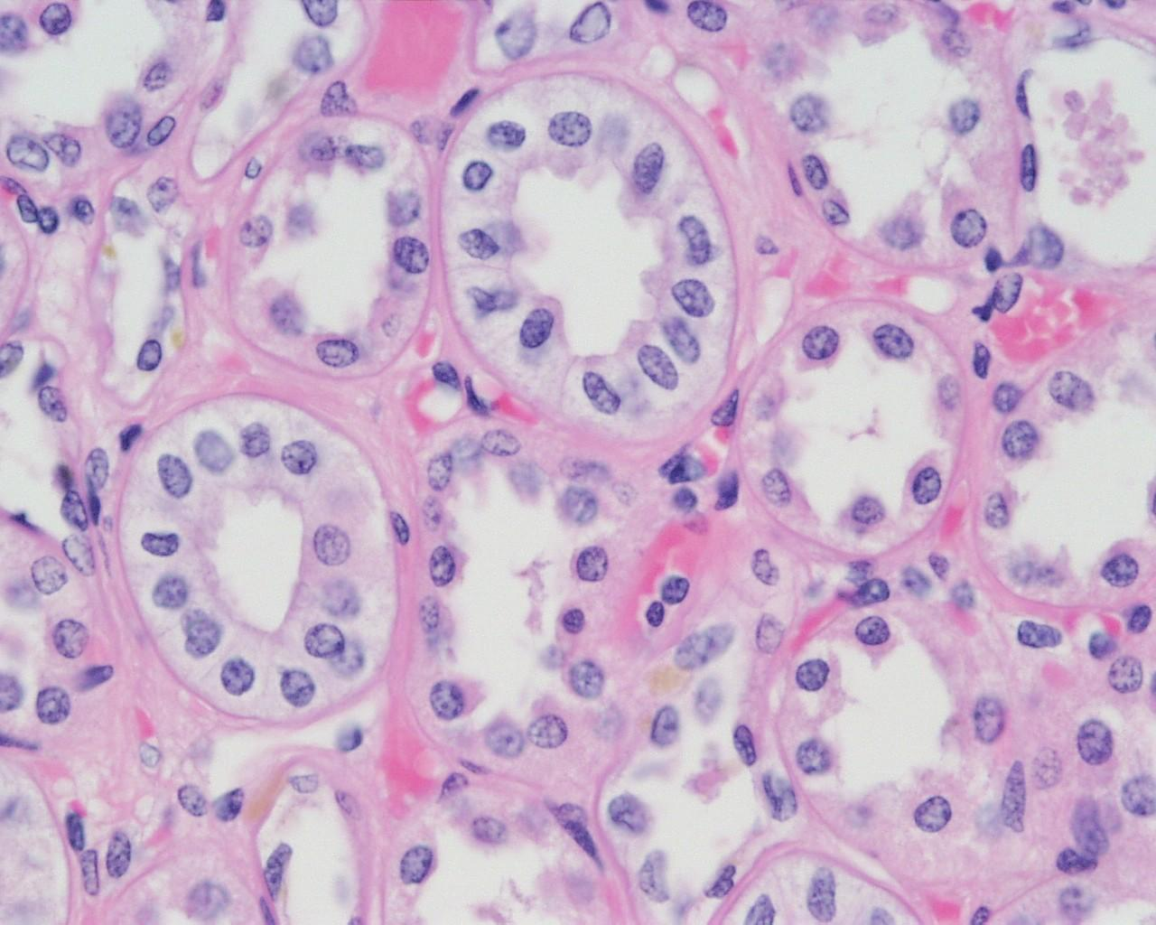
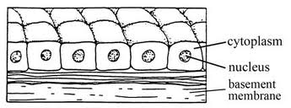
Simple cuboidal, kidney tubule,
Secretion/absorption
Notes:
Simple cuboidal, kidney tubule

Slide 11
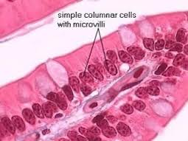
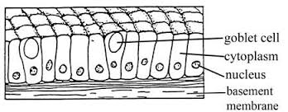
Simple columnar, ileum of small intestine,
Secretion/absorption
Notes:
Simple columnar, ileum of small intestine

Slide 12
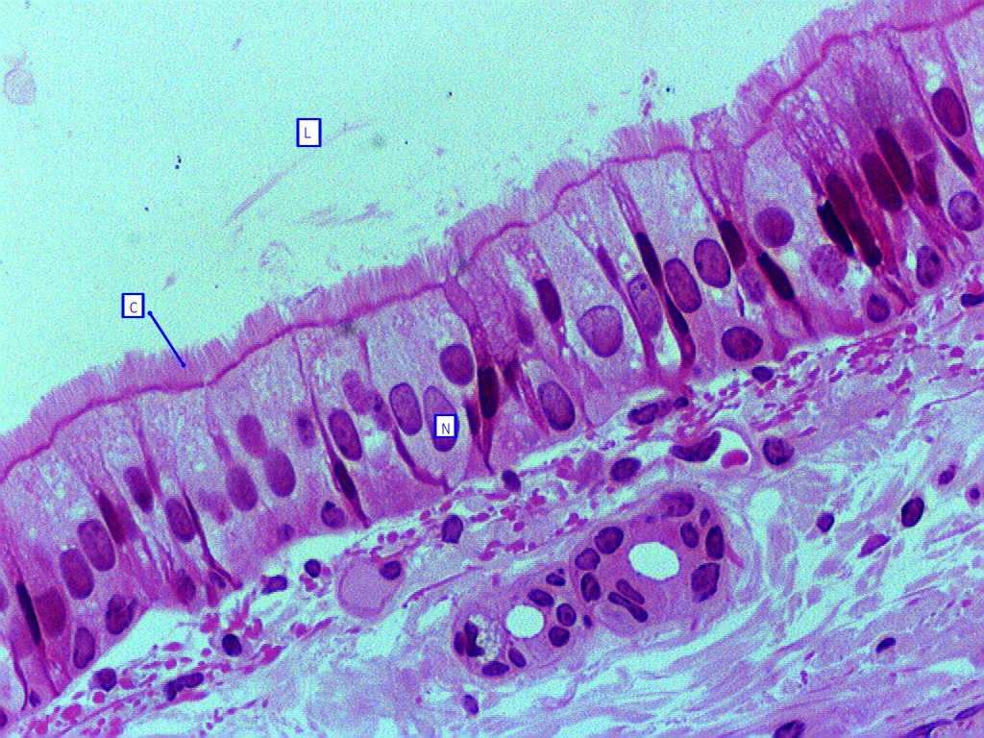
Pseudostratified columnar epithelial (ciliated), trachea, Secretion/transport
Notes:
Pseudostratified columnar epithelial (ciliated), trachea

Slide 13
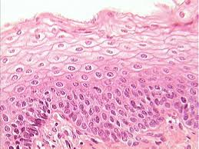
Stratified squamous, esophagus,
protection
Notes:
Stratified squamous, esophagus

Slide 14
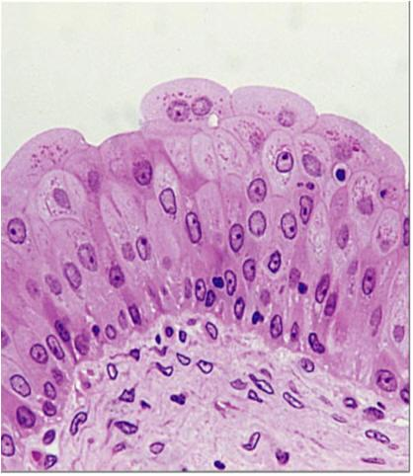
Transitional epithelium, bladder, protection/stretch
Notes:
Transitional epithelium, bladder

Slide 15
Connective Tissues

Slide 16
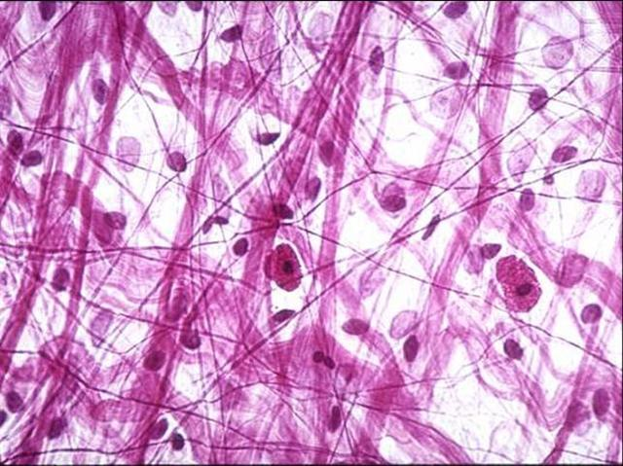
Areolar connective tissue, cushioning most organs
- “Prototype” for all other connective tissues
Notes:
Areolar connective tissue, cushioning most organs

Slide 17
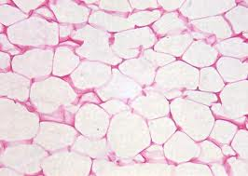
Adipose, cushioning most places
Notes:
Adipose, cushioning most places

Slide 18
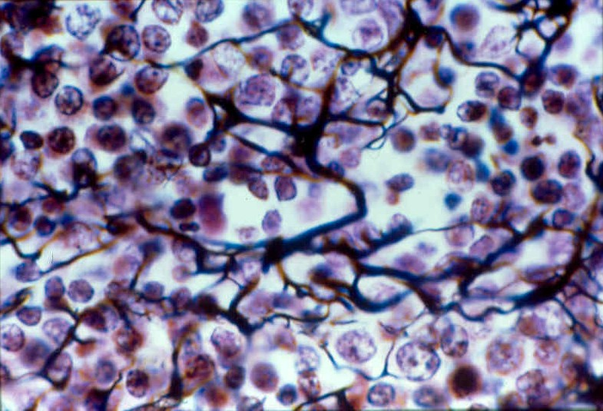
Reticular connective tissue, lymphoid organs
Notes:
Reticular connective tissue, lymphoid organs

Slide 19
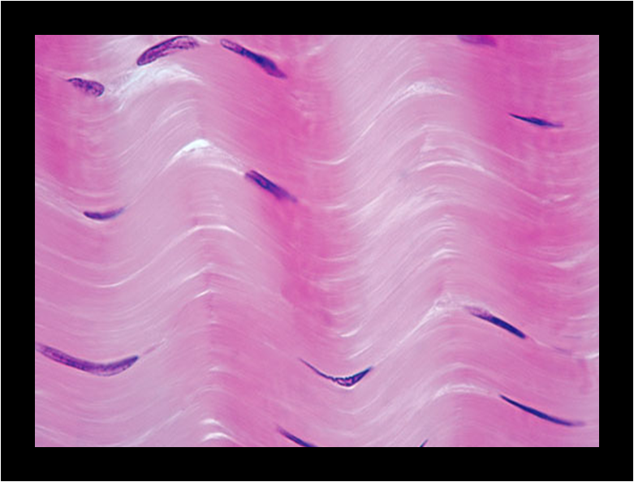
Dense regular connective tissue, tendons/ligaments
Notes:
Dense regular connective tissue, tendons/ligaments

Slide 20
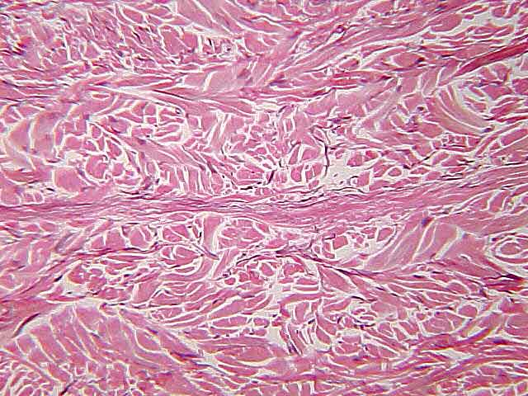
Dense irregular connective tissue, dermis of skin
Notes:
Dense irregular connective tissue, dermis of skin

Slide 21
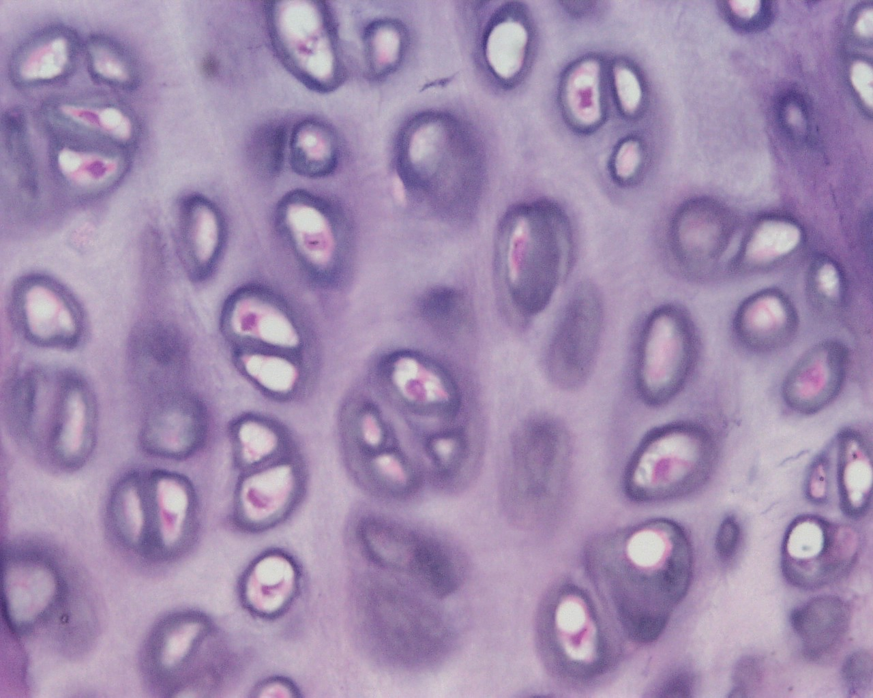
Cartilage (elastic, hyaline, fibro), trachea
Observe: Chondrocytes in lacunae
Notes:
Cartilage (elastic, hyaline, fibro), trachea

Slide 22
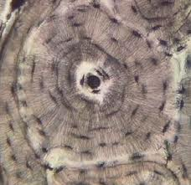
Bone, skeleton
Notes:
Bone, skeleton

Slide 23
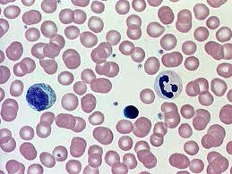
blood
Notes:
blood

Slide 24
Muscle Tissues

Slide 25
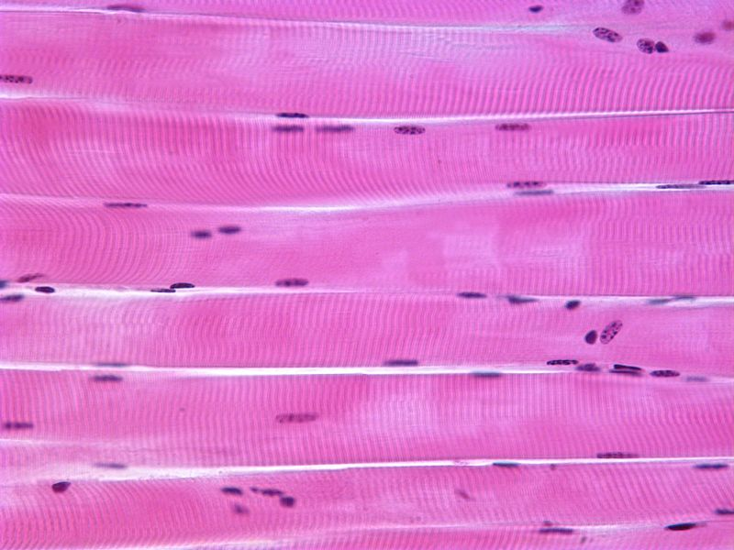
Skeletal muscle, muscle
Observe: Striations and multiple cell nuclei in each muscle strand
Notes:
Skeletal muscle, muscle

Slide 26
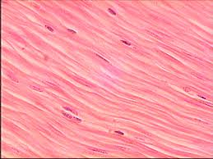
Smooth muscle, uterus
Notes:
Smooth muscle, uterus

Slide 27
Smooth muscle tissue
Dense regular connective tissue
Cell nuclei “inside” bands of tissue
Cell nuclei “between” bands of tissue

Slide 28
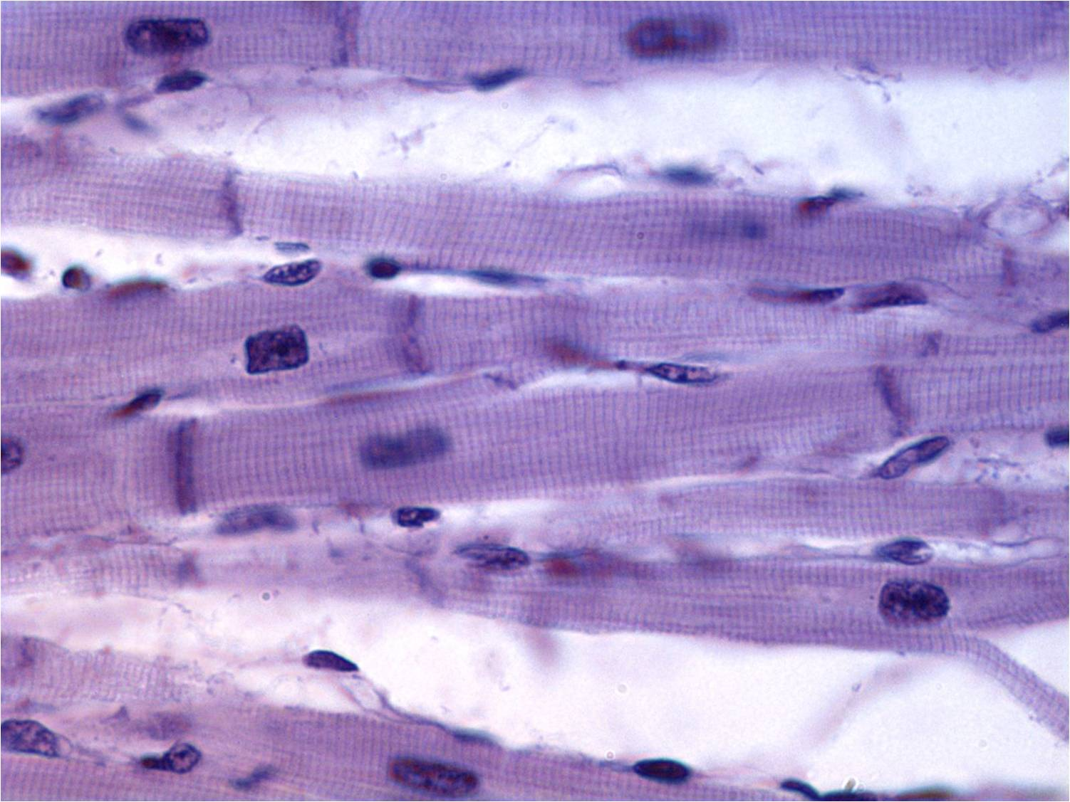
Cardiac muscle, heart only
Observe: striations, multiple cell nuclei and intercalated discs
Notes:
Cardiac muscle, heart only

Slide 29
Nervous Tissues

Slide 30
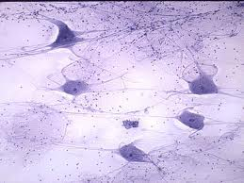
Nervous tissue, spinal cord
Notes:
Nervous tissue, spinal cord

Slide 31
Integumentary System

Slide 32
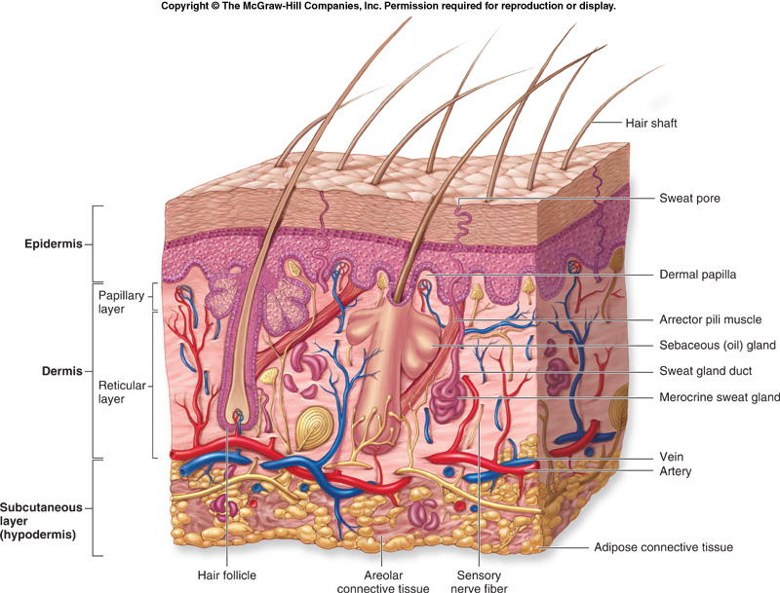
Areolar CT
(Sudiferous glands)
Dense
irregular CT
Adipose CT

Slide 33
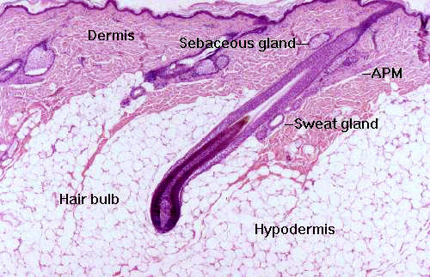
Notes:
Integument, thin skin

